Slide 1


SRI SIDDHARTHA ACADEMY OF HIGHER EDUCATION (DEEMED TO BE UNIVERSITY, Accredited A⁺ Grade by NAAC) Sri Siddhartha Institute of Technology-Tumakuru (A CONSTITUENT COLLEGE OF SSAHE) Department of Electronics & Communication Engineering (ACCREDITED BY NBA)
Mini Project Work (EC6MP2) - Problem Definition Seminar
on
“ROBOTIC ARM”
Presented By:
Prajwal K Jantli (21EC071)
Pruthvi Raj H (21EC073)
Srivatsa S (21EC093)
Vinay S H (21EC105)
Under the Guidance of:
Dr.KOMALA.K M.Tech.,Ph.D..
Assistant Professor
Dept. of ECE, SSIT
23/03/2024

Slide 2
Dream High
OUTLINE
INTRODUCTION
LITERATURE SURVEY
PROBLEM STATEMENT
BLOCK DIAGRAM
CONCLUSION
REFERENCES

Slide 3
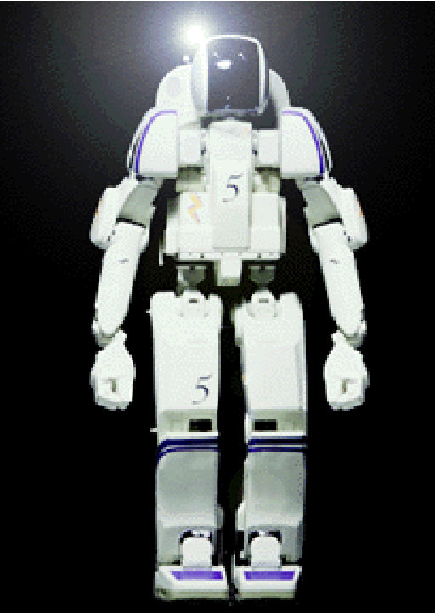
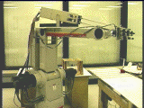
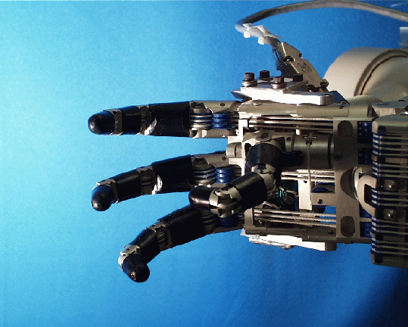
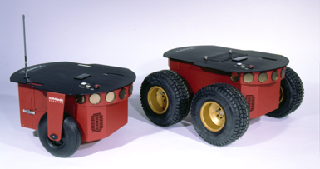
Dream High
INTRODUCTION
The term robot has come from the Czech word robota .
According to Oxford English Dictionary-
A machine capable of carrying out a complex series of actions automatically, especially one programmable by a computer. This is changing ,however.

Slide 4
Dream High
Since the beginning of the industrial revolution mechanical engineers developed machines to ease on the workforce.
Electricity and computer science provided the gateway to something new – Robotics!
The current technology allows us to build machines that are capable of performing human-like actions to do so robots must have similar autonomy consisting moving parts that are electromechanically driven.
And a “brain” component to control them by following pre-determined instructions, or make them make up on its own.

Slide 5
Dream High
Motivation
To cope with increasing demands of a dynamic and competitive market, modern manufacturing methods should satisfy the following requirements.
Reduced production cost.
Increased productivity.
Improved product quality.
Objectives
Increased efficiency .
Do repetitive tasks.
Higher precision and accuracy.
Safe and flexible.

Slide 6
Dream High
LITERATURE SURVEY
Sl. No | TITLE of the Paper | AUTHORs, YEAR & PUBLICATION | OBSERVATIONS | HARDWARE USED
1. | An Automated Robotic Arm: A Machine Learning Approach. | Krishnaraj Rao N S, Avinash N J, Rama Moorthy H, Karthik K, Sudesh Rao, Santosh S. [2021 IEEE International Conference on Mobile Networks and Wireless Communications (ICMNWC)]-Karnataka, India. | This paper proposes the design and operation of an automated robotic arm using machine learning for object identification and traversal, utilizing the TensorFlow package to achieve precise results. | Rasberry Pi, camera module, gripper, robotic arm, servo motors, ultrasonic sensor, barometric pressure sensor,

Slide 7
Dream High
LITERATURE SURVEY
Sl. No | TITLE of the Paper | AUTHORs, YEAR & PUBLICATION | OBSERVATIONS | HARDWARE USED
2. | Design and Development of IoT based Robotic Arm by using Arduino. | Navin Kumar Agrawal, Vinay Kumar Singh, Vinay Singh Parmar, Vijay Kumar Sharma, Dipti Singh, Muskan Agrawal. [IEEE 2020 Fourth International Conference on Computing Methodologies and Communication (ICCMC)] - Erode, India | This paper is presenting the process through which robotic arm is made with the help of Arduino and Potentiometer for controlling and coordinating the industrial processes. | IoT (Internet of Things), Robotic Arm chassis, Potentiometer, Servo Motor, Arduino UNO, MEMS(Micro-ElectroMechanical Systems)

Slide 8
Dream High
Sl. No | TITLE of the Paper | AUTHORs, YEAR & PUBLICATION | OBSERVATIONS | HARDWARE USED
3. | GUI Based Pick and Place Robotic Arm for Multipurpose Industrial Applications | Yenorkar Rasik, Chaskar U. M. (2018).[IEEE 2018 Second International Conference on Intelligent Computing and Control Systems (ICICCS)]- Madurai, India. | Here the arm is easily manipulated and has all in one solution for the certain range of pick and place application. Their aim is to achieve the ability of commanding and controlling the arm through MATLAB Graphical User Interface (GUI) and to make the system more efficient. | AVR AT mega 328P controller, Servo Motors, MATLAB interface.

Slide 9
Dream High
Sl. No | TITLE of the Paper | AUTHORs, YEAR & PUBLICATION | OBSERVATIONS | HARDWARE USED
4. | Development of a Motion Controlled Robotic Arm | Jiang Jean, Alex McCoy, Eric Lee, Tan Li. [IEEE 2017 IEEE 8th Annual Ubiquitous Computing, Electronics and Mobile Communication Conference(UEMCON)]. | The user wears 2 accelerometers on his arm. Which relay both position and speed vector data to the controller. The user also wears a glove that controls the flex sensor which gives readings to the claw. | Robotic claw, human interface, servo motor, Arduino Uno microcontroller, accelerometers, flex sensor.

Slide 10
Dream High
Sl. No | TITLE of the Paper | AUTHORs, YEAR & PUBLICATION | OBSERVATIONS | HARDWARE USED
5. | Robotic Arm Design, Development and Control for Agriculture Applications | Rajesh Kannan Megalingam, Gedela Vamsy Vivek, Shiva Bandyopadhyay, Mohammed Juned Rahi. 4th International Conference on Advanced Computing and Communication Systems(ICACCS) 2017. | In this paper, a technique by which a robotic arm is controlled using a depth sensor is proposed. The depth sensor captures the user input and inverse kinematics algorithm is used to define the motion of the robotic arm. The movement of the human arm in 3D space is captured, processed and replicated by the robotic arm using inverse kinematics. | Arduino UNO R3, Servo motors, flex sensors, Kinect sensor.

Slide 11
Dream High
Sl. No | TITLE of the Paper | AUTHORs, YEAR & PUBLICATION | OBSERVATIONS | HARDWARE USED
6. | A soft robotic gripper with gecko-inspired adhesive. | Paul Glick, Srinivasan A Suresh, Donald Ruffatto III, (2018). IEEE Robotics and Automation Letters. | This research paper opens up possibilities for soft robotics, especially in scenarios where traditional grippers face limitations. The combination of fluidic elastomer actuators and gecko-inspired adhesives provides a promising avenue for enhancing gripping capabilities. | Fluidic elastomer actuators, gecko inspired adhesives, 3-d printed anchor.

Slide 12
Dream High
PROBLEM STATEMENT
Statement 1: Picking and placing of more number of heavy objects again and again cannot be done by the humans efficiently.
Statement 2: Humans cannot work in drainages, mines, caves or where there are high temperatures like desert, near volcanos and in low temperatures like polar regions.

Slide 13
Dream High
SOLUTION TO THE PROBLEM STATEMENT
Robots consists of moving parts that are electromechanically driven and a controller acting as a “brain” component, controlling them by following pre-determined instructions or make them fully automated using appropriate sensors making them fully efficient.
Robots are made up of hard materials which they can resist the high and low temperatures,
and they can be designed in any sizes and controlled via wired or wireless.

Slide 14
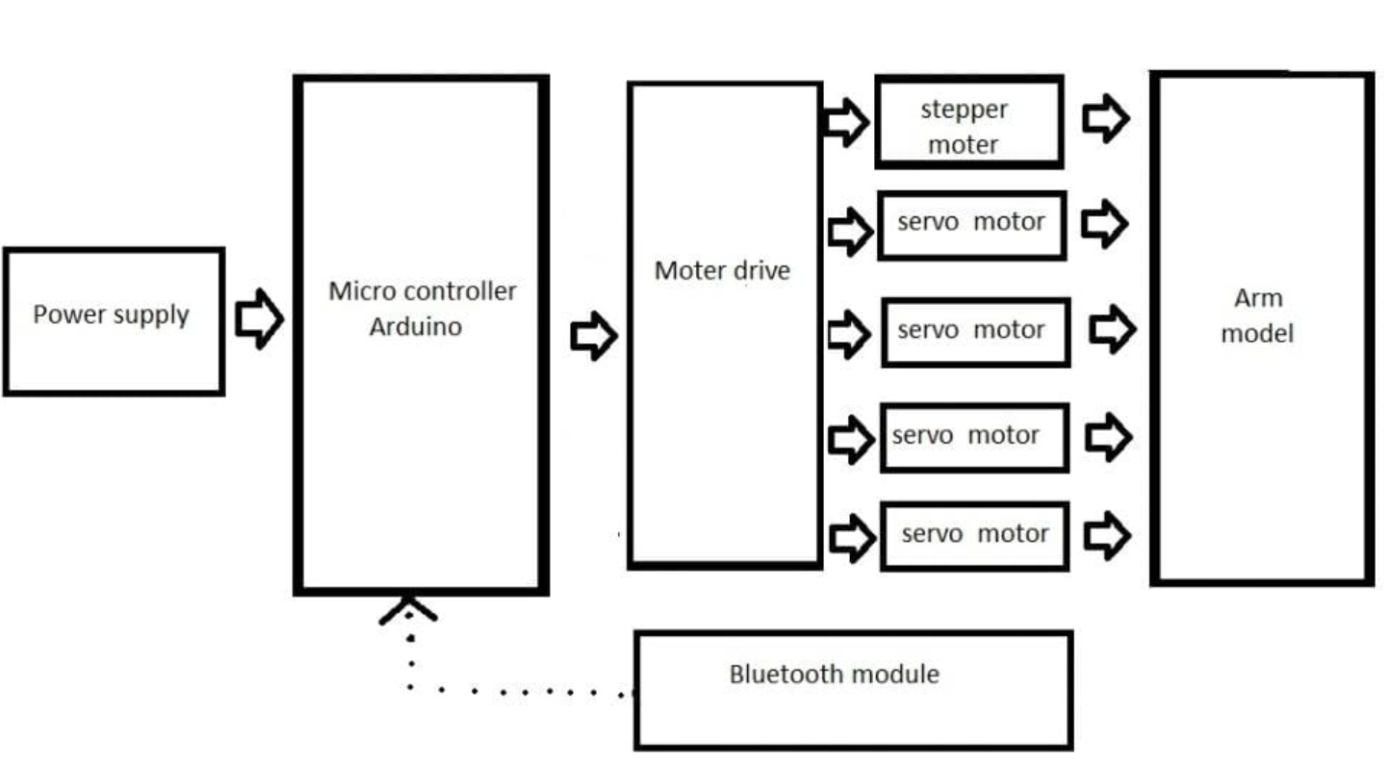

Dream High
gfjgvgodjojso
BLOCK DIAGRAM
MOBILE APPLICATION
Fig.1: Block diagram of the proposed system.

Slide 15
Dream High
CONCLUSION
The information regarding the project is gathered by referring various papers and
the literature survey is made.

Slide 16
Dream High
REFERENCES
Krishnaraj Rao N S, Avinash N J, Rama Moorthy H, Karthik K, Sudesh Rao, Santosh S.” An Automated Robotic Arm: A Machine Learning Approach.” [2021 IEEE International Conference on Mobile Networks and Wireless Communications (ICMNWC)]-Karnataka, India.
Agrawal, Navin Kumar; Singh, Vinay Kumar;Parmar, Vinay Singh; Sharma, Vijay Kumar;Singh, Dipti; Agrawal, Muskan.”Design and Development of loT based Robotic Arm by using Arduino.” [IEEE2020 Fourth International Conference on Computing Methodologies and Communication (ICCMC)] – Erode-India.
Yenorkar, Rasika; Chaskar, U. M. (2018). ”GUI Based Pick and Place Robotic Arm for Multipurpose Industrial Applications.”- 2018 Second International Conference on Intelligent Computing and Control Systems (ICICCS).

Slide 17
Dream High
4. Jean Jiang, AlexMcCoy, Eric Lee, Li Tan, (2017). [IEEE 2017 IEEE 8th Annual Ubiquitous Computing, Electronics and Mobile Communication Conference(UEMCON) - New York City, “Development of a motion controlled robotic arm.”
5. Rajesh Kannan Megalingam, Gedela Vamsy Vivek, Shiva Bandyopadhyay, Mohammed Juned Rahi.” Robotic Arm Design, Development and Control for Agriculture Applications .“4th International Conference on Advanced Computing and Communication Systems(ICACCS) 2017.
6. Paul Glick, Srinivasan A Suresh, Donald Ruffatto III, (2018). “A soft robotic gripper with gecko-inspired adhesive.” IEEE Robotics and Automation Letters.

